Slide 1
IBM Carbon TreeView
Example 03

Slide 2
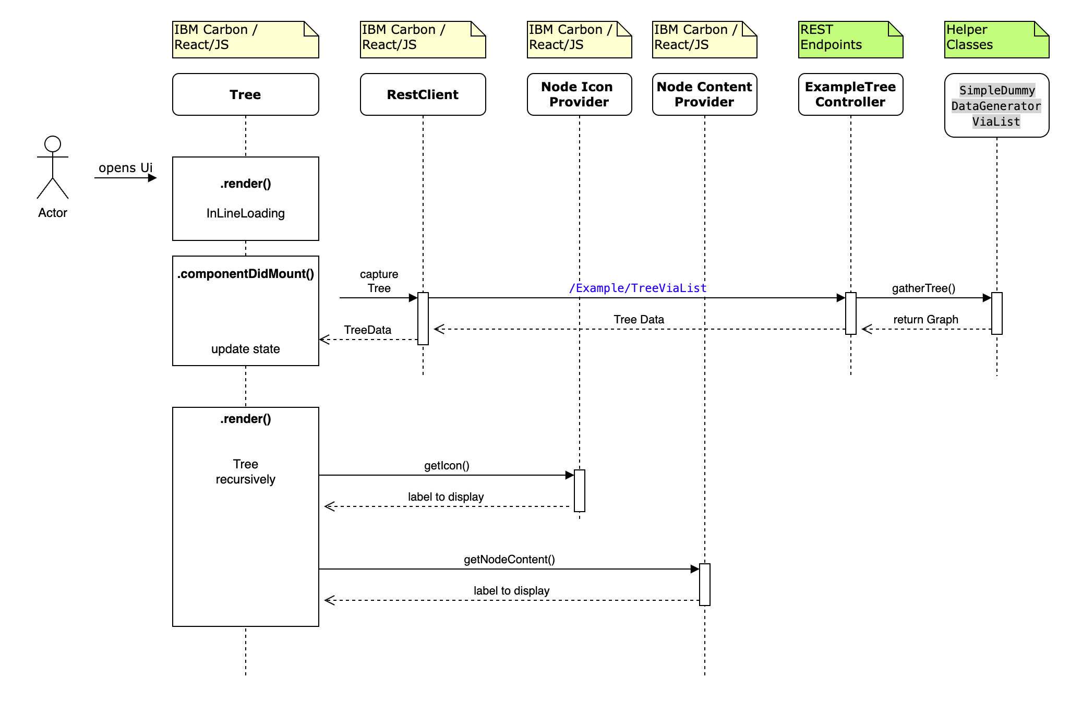
Sequence Diagram
2
1

Slide 3
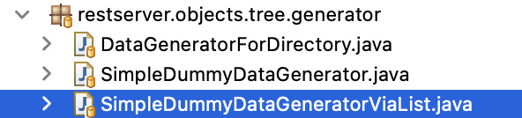
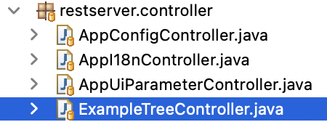
Server-sided Sources
1
2
Notes:
Here: Show one of Example Endpoints in Swagger

Slide 4
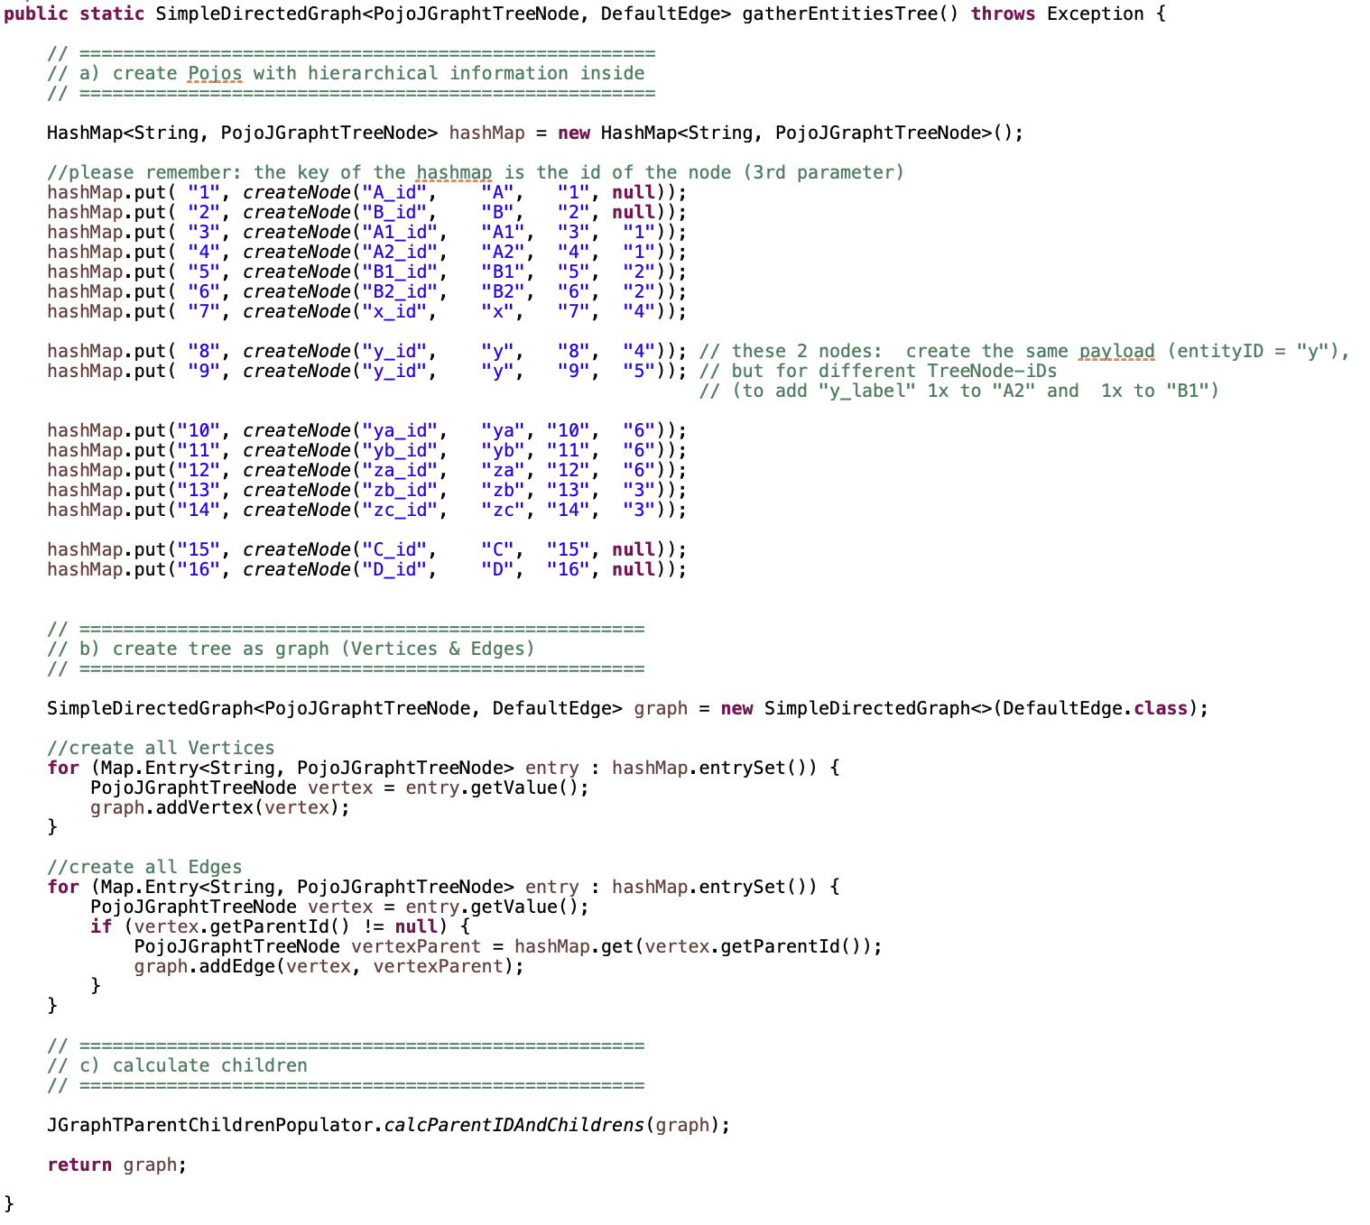
1
This might come
from a database
Build Graph
via JGraphT
Grant ParentID
& Children

Slide 5
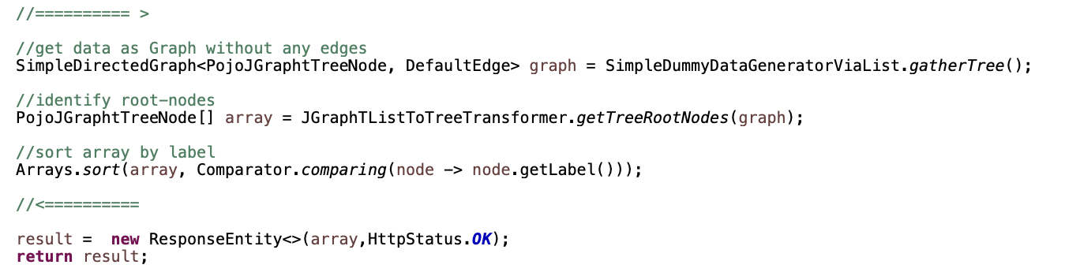
2
Notes:
root-nodes … there can be more than one
Array.sort … to present a sorted output

Slide 6
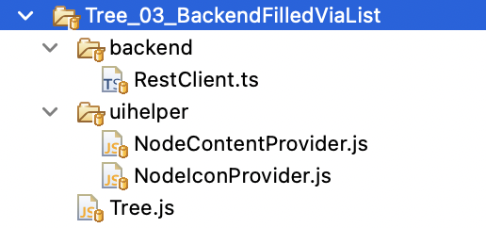
Client-sided Sources
Notes:
Let’s have a look at these sources

